Slide 1

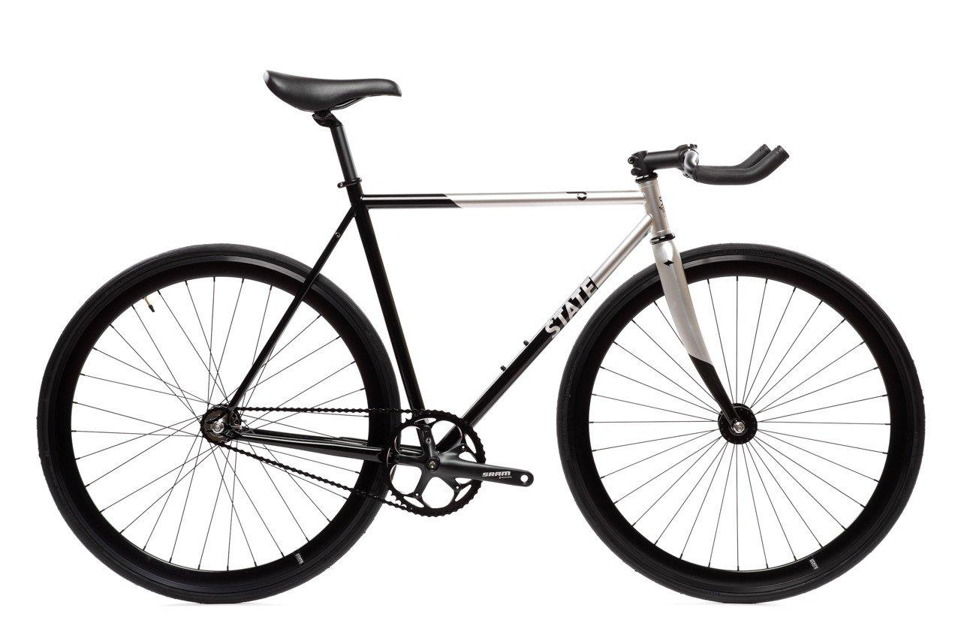
CS 684 - Embedded Systems
Spring 2018
iP l
Kedar Anavardekar
Shinjan Mitra
Sapan Tanted

Slide 2



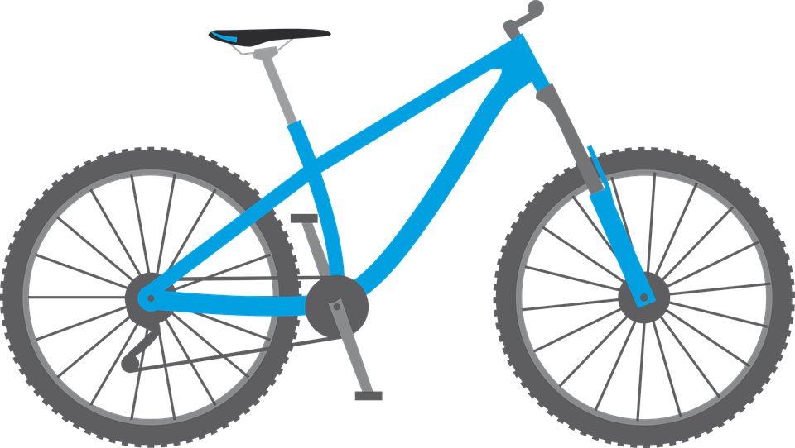
Problem Statement
Public bicycle sharing system.
Build a device that can be fitted onto any bicycle that has been lent to the pool and enable the owner to earn dividends.
Any user will be able to rent a bicycle using a companion mobile app which will start and end the ride.
STARTING = UNLOCKING
ENDING = LOCKING
The device will be able to function in an offline mode i.e. without either the device or companion mobile app having internet connectivity
iPool

Slide 3


PhoTx - Novel Communication Technique
Transmission of data using light (Photon Tx transmission).
Use mobile phone flashlight to transmit signals.
Receive using simple LDR or photodiode.
No connection establishment required.
Completely offline.

Slide 4
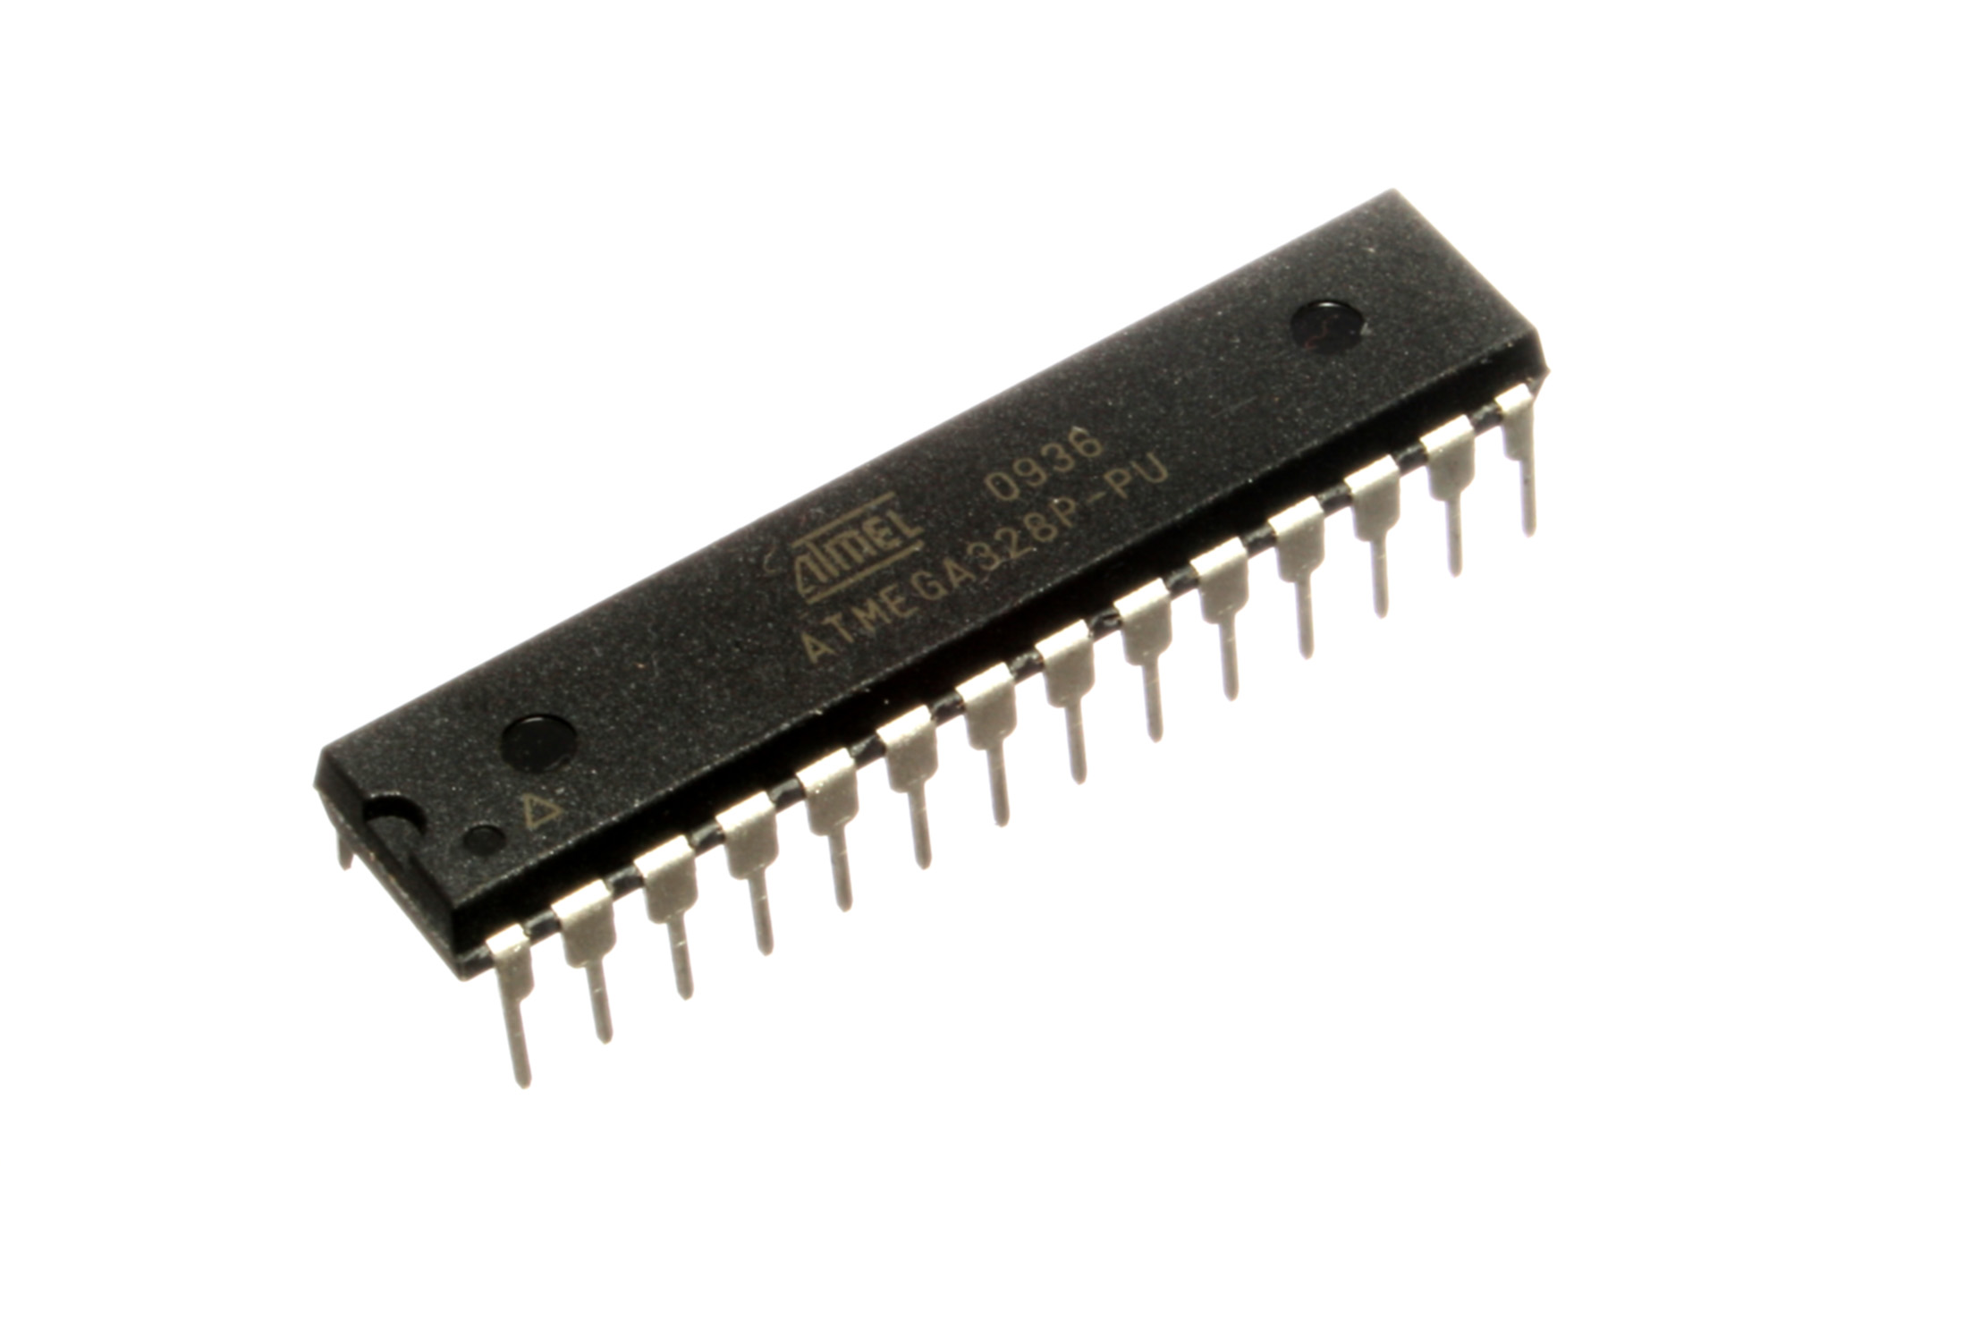
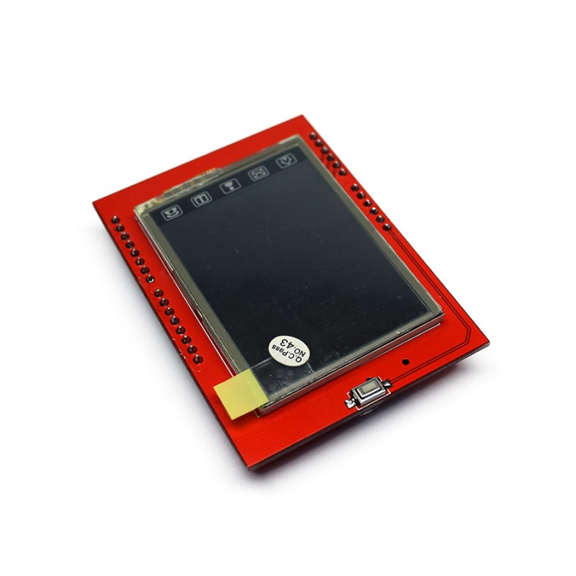
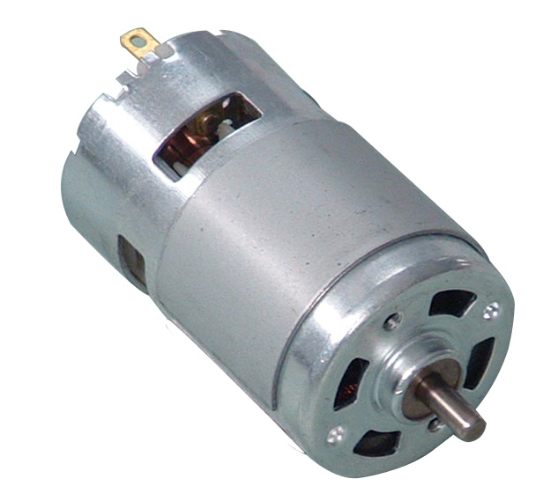
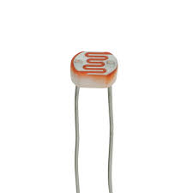
Requirements
Hardware
Low powered microcontroller (Atmega 328P)
2.4” LCD display
Motors and mechanical components for lock
Photodiode / LDR
Software
Cordova / Android Studio – mobile app
Node.js – Server side
Arduino – microcontroller programming
This Photo by Unknown Author is licensed under CC BY-NC-ND
This Photo by Unknown Author is licensed under CC BY-SA
This Photo by Unknown Author is licensed under CC BY-NC-ND

Slide 5
Challenges
Working of PhoTx in all environmental conditions.
Encoding and encryption of data sent over PhoTx.
Provide fallback to PhoTx system.
Maintainable device design for easy repair and replacement.
Implementing a secure tamper-proof lock.
Creating intuitive UI/UX for end user.
Design the enclosure of lock components and electronics.
Payment gateway integration.

Slide 6


Deliverables
Hardware and software
Mobile App
Prototype of iPool lock mountable on a bicycle
Working PhoTx transmission system.
Web application with monitoring dashboard

Slide 7
Test Strategies (for the claimed deliverables)
Unit testing
Junit for mobile app
On-field deployed PhoTx testing
Load testing of server (using Jmeter)
Integration testing
Mobile app – Server API integration
Mobile app – PhoTx integration
Electronics – Lock integration
System integration
Alpha testing – End to end system

Slide 8
Timeline
Should show weekly deadlines
Lock
2W
Design (Fusion 360)
1W
Cardboard design
1W
3D-printed model
1W
Electronics integration
App & Server
1W
Design
1W
Basic App layout
1W
APIs
1W
Testing with lock
1W
SYSTEM TESTING
Electronics
1W Design
1W
Building circuitry
1W
Software Integration
1W
Lock integration

Slide 9
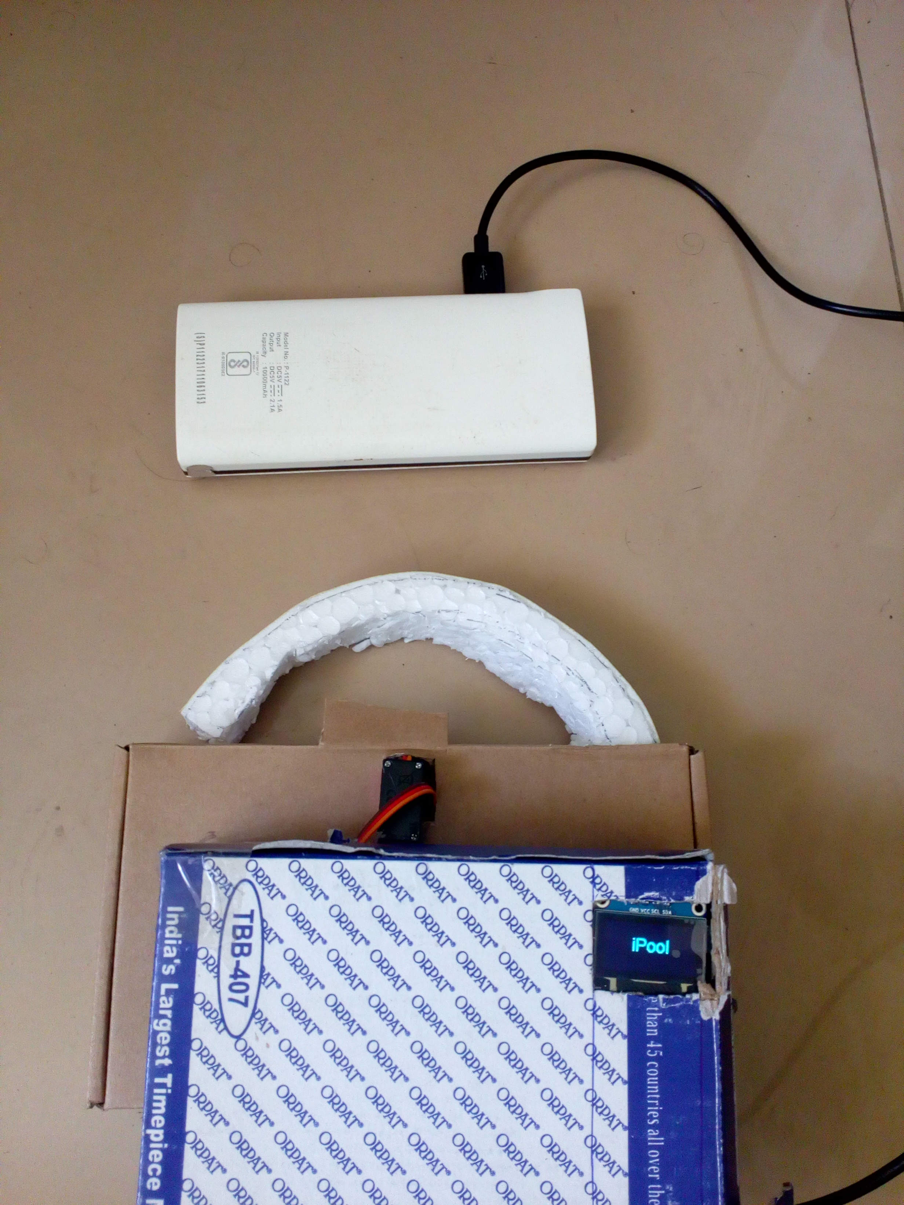
Product prototype
Working model of lock with PhoTx and offline mode capability.
Built with offline first approach.

